Slide 1

Predicting Microsoft Stock Prices Using Advanced Machine Learning Models: A Comprehensive Analysis and Trading Strategy
Objectives
Key Objectives:
Forecast stock prices using historical and sentiment data.
Build and evaluate state-of-the-art machine learning models.
Develop a trading strategy to generate profitable signals.
Backtest and analyze the portfolio’s performance.
Deliverables:
Model performance metrics (RMSE).
Trading signals (Buy, Sell, Hold).
Backtesting results.
Add goal-oriented icons (forecasting, trading, financial growth).
Predicting Microsoft Stock Prices Using Advanced Machine Learning Models: A Comprehensive Analysis and Trading Strategy
GROUP 2
Priyank
Somesh
Sakshi
Shivam

Slide 2
Objectives
Key Objectives:
Forecast stock prices using historical and sentiment data.
Build and evaluate state-of-the-art machine learning models.
Develop a trading strategy to generate profitable signals.
Backtest and analyze the portfolio’s performance.
Deliverables:
Model performance metrics (RMSE).
Trading signals (Buy, Sell, Hold).
Backtesting results.
Add goal-oriented icons (forecasting, trading, financial growth).
Objectives
Key Objectives:
Forecast stock prices using historical and sentiment data.
Build and evaluate state-of-the-art machine learning models.
Develop a trading strategy to generate profitable signals.
Backtest and analyze the portfolio’s performance.
Deliverables:
Model performance metrics (RMSE).
Trading signals (Buy, Sell, Hold).
Backtesting results.
Add goal-oriented icons (forecasting, trading, financial growth).
Data Sources
Stock Data:
Collected from Yahoo Finance (MSFT stock).
Features: Open, High, Low, Close, Volume, Adjusted Close.
Sentiment Analysis:
Simulated news headlines scored using SentimentIntensityAnalyzer.
Sentiment included as a feature.
Processing:
Time range: 2010-01-01 to the present.
Sequence length: 60 days of historical data for predictions.
Include a table sample of raw data (stock features and sentiment).

Slide 3
Data Sources
Stock Data:
Collected from Yahoo Finance (MSFT stock).
Features: Open, High, Low, Close, Volume, Adjusted Close.
Sentiment Analysis:
Simulated news headlines scored using SentimentIntensityAnalyzer.
Sentiment included as a feature.
Processing:
Time range: 2010-01-01 to the present.
Sequence length: 60 days of historical data for predictions.
Include a table sample of raw data (stock features and sentiment).
Data Sources
Stock Data:
Collected from Yahoo Finance (MSFT stock).
Features: Open, High, Low, Close, Volume, Adjusted Close.
Sentiment Analysis:
Simulated news headlines scored using SentimentIntensityAnalyzer.
Sentiment included as a feature.
Processing:
Time range: 2010-01-01 to the present.
Sequence length: 60 days of historical data for predictions.
Include a table sample of raw data (stock features and sentiment).
Feature Engineering
Raw Data Extraction:
Retrieved MSFT stock data (Open, High, Low, Close, Volume, Adjusted Close) using yfinance.
Date-Based Features:
Extracted features: Day, Month, Year, Day of Week.
Sentiment Analysis:
Simulated news headlines scored with SentimentIntensityAnalyzer from NLTK.
Scaling:
Applied MinMaxScaler to normalize numerical features (e.g., prices, sentiment scores).
Sequence Preparation:
Generated rolling 60-day windows as input for models

Slide 4
Feature Engineering
Raw Data Extraction:
Retrieved MSFT stock data (Open, High, Low, Close, Volume, Adjusted Close) using yfinance.
Date-Based Features:
Extracted features: Day, Month, Year, Day of Week.
Sentiment Analysis:
Simulated news headlines scored with SentimentIntensityAnalyzer from NLTK.
Scaling:
Applied MinMaxScaler to normalize numerical features (e.g., prices, sentiment scores).
Sequence Preparation:
Generated rolling 60-day windows as input for models
Feature Engineering
Raw Data Extraction:
Retrieved MSFT stock data (Open, High, Low, Close, Volume, Adjusted Close) using yfinance.
Date-Based Features:
Extracted features: Day, Month, Year, Day of Week.
Sentiment Analysis:
Simulated news headlines scored with SentimentIntensityAnalyzer from NLTK.
Scaling:
Applied MinMaxScaler to normalize numerical features (e.g., prices, sentiment scores).
Sequence Preparation:
Generated rolling 60-day windows as input for models
Libraries Used
Data Collection:
yfinance: Fetch historical stock data.
Feature Engineering:
NLTK: Perform sentiment analysis using SentimentIntensityAnalyzer.
Pandas and NumPy: Data manipulation and feature extraction.
Scikit-Learn: Scaling features with MinMaxScaler.
Model Implementation:
TensorFlow and Keras: Build and train deep learning models.
Visualization:
Matplotlib: Generate performance plots (e.g., loss curves).

Slide 5
Libraries Used
Data Collection:
yfinance: Fetch historical stock data.
Feature Engineering:
NLTK: Perform sentiment analysis using SentimentIntensityAnalyzer.
Pandas and NumPy: Data manipulation and feature extraction.
Scikit-Learn: Scaling features with MinMaxScaler.
Model Implementation:
TensorFlow and Keras: Build and train deep learning models.
Visualization:
Matplotlib: Generate performance plots (e.g., loss curves).
Libraries Used
Data Collection:
yfinance: Fetch historical stock data.
Feature Engineering:
NLTK: Perform sentiment analysis using SentimentIntensityAnalyzer.
Pandas and NumPy: Data manipulation and feature extraction.
Scikit-Learn: Scaling features with MinMaxScaler.
Model Implementation:
TensorFlow and Keras: Build and train deep learning models.
Visualization:
Matplotlib: Generate performance plots (e.g., loss curves).
Model Architectures Overview
Models Compared:
Transformer: Captures long-range dependencies.
LSTM: Learns long-term sequential trends.
GRU: Simplifies temporal modeling with gates.
CNN-LSTM: Combines local feature extraction and sequential learning.
Create a side-by-side comparison table highlighting:
Model strengths.
Unique features (e.g., attention for Transformer).

Slide 6
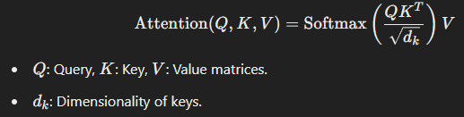
Model Architectures Overview
Models Compared:
Transformer: Captures long-range dependencies.
LSTM: Learns long-term sequential trends.
GRU: Simplifies temporal modeling with gates.
CNN-LSTM: Combines local feature extraction and sequential learning.
Create a side-by-side comparison table highlighting:
Model strengths.
Unique features (e.g., attention for Transformer).
Model Architectures Overview
Models Compared:
Transformer: Captures long-range dependencies.
LSTM: Learns long-term sequential trends.
GRU: Simplifies temporal modeling with gates.
CNN-LSTM: Combines local feature extraction and sequential learning.
Create a side-by-side comparison table highlighting:
Model strengths.
Unique features (e.g., attention for Transformer).
Transformer Model
Architecture:
Multi-head attention layer for dependencies across time steps.
Convolutional layers for feature extraction.
Dense layer for final prediction.
Mathematics:
Attention mechanism:
Why Transformer?
Efficient at capturing patterns over long sequences.
Model Summary:
Input: Sequences of 60 timesteps with 10 features.
Key Layers:
Multi-Head Attention: 4 heads, dropout (0.1) for capturing dependencies.
Layer Normalization: Stabilizes training.
Conv1D: 128 filters, kernel size 1, ReLU activation for feature extraction.
Global Average Pooling: Reduces dimensionality.
Dense Layer: Linear activation for stock price prediction.
Optimizer: Adam | Loss Function: Mean Squared Error (MSE).

Slide 7
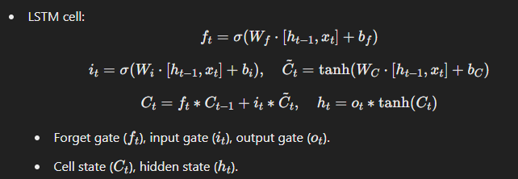
Transformer Model
Transformer Model
LSTM Model
Architecture:
Multi-head attention layer for dependencies across time steps.
Convolutional layers for feature extraction.
Dense layer for final prediction.
Mathematics:
Attention mechanism:
Why Transformer?
Efficient at capturing patterns over long sequences.
Architecture:
Multi-head attention layer for dependencies across time steps.
Convolutional layers for feature extraction.
Dense layer for final prediction.
Mathematics:
Attention mechanism:
Why Transformer?
Efficient at capturing patterns over long sequences.
Architecture:
Two stacked LSTM layers with dropout and dense output.
Mathematics:
LSTM cell:
Why LSTM?
Captures long-term dependencies effectively.
Feature Engineering
Temporal Features:
Extracted day, month, year, day of the week.
Sentiment Analysis:
Tool: NLTK’s VADER
Process: Sentiment scoring, handling missing values
3.Scaling & Normalization:
Tool: MinMaxScaler
Model Summary:
Input: Sequences of 60 timesteps with 10 features.
Key Layers:
Multi-Head Attention: 4 heads, dropout (0.1) for capturing dependencies.
Layer Normalization: Stabilizes training.
Conv1D: 128 filters, kernel size 1, ReLU activation for feature extraction.
Global Average Pooling: Reduces dimensionality.
Dense Layer: Linear activation for stock price prediction.
Optimizer: Adam | Loss Function: Mean Squared Error (MSE).
Model Summary:
Input: Sequences of 60 timesteps with 10 features.
Key Layers:
Multi-Head Attention: 4 heads, dropout (0.1) for capturing dependencies.
Layer Normalization: Stabilizes training.
Conv1D: 128 filters, kernel size 1, ReLU activation for feature extraction.
Global Average Pooling: Reduces dimensionality.
Dense Layer: Linear activation for stock price prediction.
Optimizer: Adam | Loss Function: Mean Squared Error (MSE).
Model Summary:
Input: Sequences of 60 timesteps with 10 features.
Key Layers:
LSTM Layer 1: 128 units, returns sequences for the next layer.
LSTM Layer 2: 64 units with dropout (0.2).
Dense Layer: Linear activation for stock price prediction.
Regularization: Dropout layers after each LSTM to reduce overfitting.
Optimizer: Adam | Loss Function: Mean Squared Error (MSE).

Slide 8
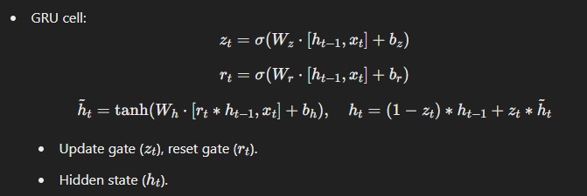
LSTM Model
LSTM Model
GRU Model
Architecture:
Two stacked LSTM layers with dropout and dense output.
Mathematics:
LSTM cell:
Why LSTM?
Captures long-term dependencies effectively.
Architecture:
Two stacked LSTM layers with dropout and dense output.
Mathematics:
LSTM cell:
Why LSTM?
Captures long-term dependencies effectively.
Architecture:
Two stacked GRU layers with dropout and dense output.
Mathematics:
GRU cell:
Why GRU?
Simpler and faster than LSTM. Visuals:
Model Summary:
Input: Sequences of 60 timesteps with 10 features.
Key Layers:
LSTM Layer 1: 128 units, returns sequences for the next layer.
LSTM Layer 2: 64 units with dropout (0.2).
Dense Layer: Linear activation for stock price prediction.
Regularization: Dropout layers after each LSTM to reduce overfitting.
Optimizer: Adam | Loss Function: Mean Squared Error (MSE).
Model Summary:
Input: Sequences of 60 timesteps with 10 features.
Key Layers:
LSTM Layer 1: 128 units, returns sequences for the next layer.
LSTM Layer 2: 64 units with dropout (0.2).
Dense Layer: Linear activation for stock price prediction.
Regularization: Dropout layers after each LSTM to reduce overfitting.
Optimizer: Adam | Loss Function: Mean Squared Error (MSE).
Model Summary:
Input: Sequences of 60 timesteps with 10 features.
Key Layers:
GRU Layer 1: 128 units, returns sequences for the next layer.
GRU Layer 2: 64 units with dropout (0.2).
Dense Layer: Linear activation for stock price prediction.
Efficiency: Fewer parameters compared to LSTM.
Optimizer: Adam | Loss Function: Mean Squared Error (MSE).

Slide 9
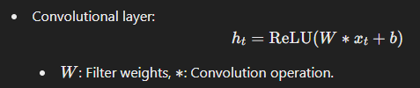
GRU Model
GRU Model
CNN-LSTM Model
Architecture:
Two stacked GRU layers with dropout and dense output.
Mathematics:
GRU cell:
Why GRU?
Simpler and faster than LSTM. Visuals:
Architecture:
Two stacked GRU layers with dropout and dense output.
Mathematics:
GRU cell:
Why GRU?
Simpler and faster than LSTM. Visuals:
Architecture:
Convolutional layers for feature extraction.
LSTM layers for temporal modeling.
Mathematics:
Convolutional layer:
Why CNN-LSTM?
Captures local and sequential patterns simultaneously.
Model Summary:
Input: Sequences of 60 timesteps with 10 features.
Key Layers:
GRU Layer 1: 128 units, returns sequences for the next layer.
GRU Layer 2: 64 units with dropout (0.2).
Dense Layer: Linear activation for stock price prediction.
Efficiency: Fewer parameters compared to LSTM.
Optimizer: Adam | Loss Function: Mean Squared Error (MSE).
Model Summary:
Input: Sequences of 60 timesteps with 10 features.
Key Layers:
GRU Layer 1: 128 units, returns sequences for the next layer.
GRU Layer 2: 64 units with dropout (0.2).
Dense Layer: Linear activation for stock price prediction.
Efficiency: Fewer parameters compared to LSTM.
Optimizer: Adam | Loss Function: Mean Squared Error (MSE).
Model Summary:
Input: Sequences of 60 timesteps with 10 features.
Key Layers:
Conv1D Layer 1: 64 filters, kernel size 3, ReLU activation.
Conv1D Layer 2: 64 filters, kernel size 3, ReLU activation.
MaxPooling1D: Pool size 2 for downsampling.
LSTM Layer: 50 units for sequential modeling.
Dense Layer: Linear activation for stock price prediction.
Optimizer: Adam | Loss Function: Mean Squared Error (MSE).

Slide 10
Dependencies & Installation
CNN-LSTM Model
CNN-LSTM Model
Implementation Details
Sequence Length: 60 days.
Training and Testing:
Training: 80%.
Testing: 20%.
Training Parameters:
Optimizer: Adam.
Loss: Mean Squared Error (MSE).
Epochs: 20, Batch Size: 32.
Plot showing training and validation loss for all models.
Architecture:
Convolutional layers for feature extraction.
LSTM layers for temporal modeling.
Mathematics:
Convolutional layer:
Why CNN-LSTM?
Captures local and sequential patterns simultaneously.
Architecture:
Convolutional layers for feature extraction.
LSTM layers for temporal modeling.
Mathematics:
Convolutional layer:
Why CNN-LSTM?
Captures local and sequential patterns simultaneously.
Model Summary:
Input: Sequences of 60 timesteps with 10 features.
Key Layers:
Conv1D Layer 1: 64 filters, kernel size 3, ReLU activation.
Conv1D Layer 2: 64 filters, kernel size 3, ReLU activation.
MaxPooling1D: Pool size 2 for downsampling.
LSTM Layer: 50 units for sequential modeling.
Dense Layer: Linear activation for stock price prediction.
Optimizer: Adam | Loss Function: Mean Squared Error (MSE).
Model Summary:
Input: Sequences of 60 timesteps with 10 features.
Key Layers:
Conv1D Layer 1: 64 filters, kernel size 3, ReLU activation.
Conv1D Layer 2: 64 filters, kernel size 3, ReLU activation.
MaxPooling1D: Pool size 2 for downsampling.
LSTM Layer: 50 units for sequential modeling.
Dense Layer: Linear activation for stock price prediction.
Optimizer: Adam | Loss Function: Mean Squared Error (MSE).

Slide 11

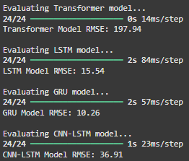
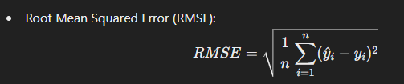
Implementation Details
Sequence Length: 60 days.
Training and Testing:
Training: 80%.
Testing: 20%.
Training Parameters:
Optimizer: Adam.
Loss: Mean Squared Error (MSE).
Epochs: 20, Batch Size: 32.
Plot showing training and validation loss for all models.
Implementation Details
Sequence Length: 60 days.
Training and Testing:
Training: 80%.
Testing: 20%.
Training Parameters:
Optimizer: Adam.
Loss: Mean Squared Error (MSE).
Epochs: 20, Batch Size: 32.
Plot showing training and validation loss for all models.
Evaluation Metrics
Root Mean Squared Error (RMSE):
RMSE (Root Mean Squared Error) measures the average prediction error in the same unit as the target variable, with lower values indicating better accuracy. It penalizes larger errors more heavily, making it sensitive to outliers.
Outcome of Phase 1:
Outcome of Phase 2:

Slide 12

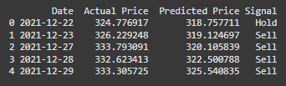
Evaluation Metrics
Evaluation Metrics
Trading Strategy
Root Mean Squared Error (RMSE):
RMSE (Root Mean Squared Error) measures the average prediction error in the same unit as the target variable, with lower values indicating better accuracy. It penalizes larger errors more heavily, making it sensitive to outliers.
Root Mean Squared Error (RMSE):
RMSE (Root Mean Squared Error) measures the average prediction error in the same unit as the target variable, with lower values indicating better accuracy. It penalizes larger errors more heavily, making it sensitive to outliers.
Signal Rules:
Buy: Predicted price > Previous day’s actual price.
Sell: Predicted price < Previous day’s actual price.
Hold: Predicted price ≈ Previous day’s price.
Execution:
Generated signals for each day using the best model (Transformer).
Line chart of actual vs. predicted prices with Buy/Sell signals.
Outcome of Phase 1:
Outcome of Phase 2:
Outcome of Phase 1:
Outcome of Phase 2:
Predicted and Actual Outcomes of Phase 1 and Phase 2 :

Slide 13
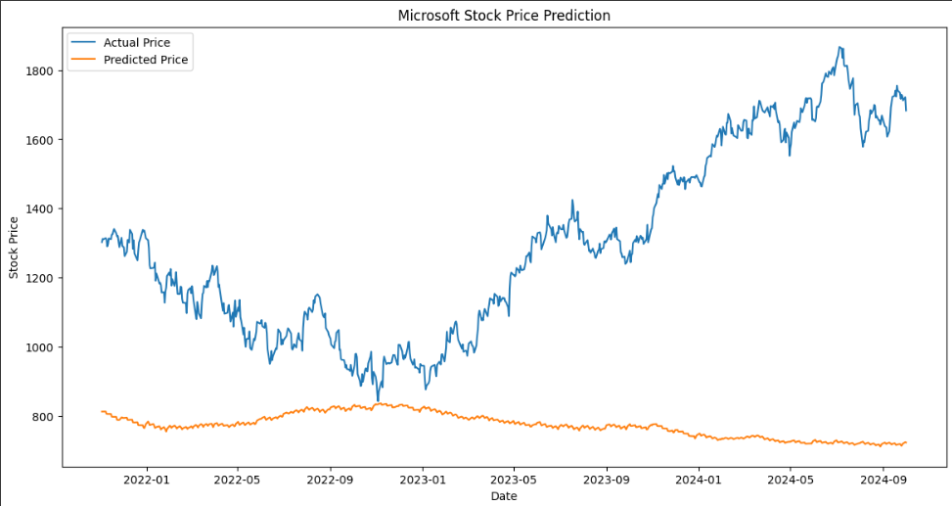
Trading Strategy
Trading Strategy
Visualizations of microsoft’s stock price prediction : Phase 1
Signal Rules:
Buy: Predicted price > Previous day’s actual price.
Sell: Predicted price < Previous day’s actual price.
Hold: Predicted price ≈ Previous day’s price.
Execution:
Generated signals for each day using the best model (Transformer).
Line chart of actual vs. predicted prices with Buy/Sell signals.
Signal Rules:
Buy: Predicted price > Previous day’s actual price.
Sell: Predicted price < Previous day’s actual price.
Hold: Predicted price ≈ Previous day’s price.
Execution:
Generated signals for each day using the best model (Transformer).
Line chart of actual vs. predicted prices with Buy/Sell signals.
Predicted and Actual Outcomes of Phase 1 and Phase 2 :
Predicted and Actual Outcomes of Phase 1 and Phase 2 :

Slide 14
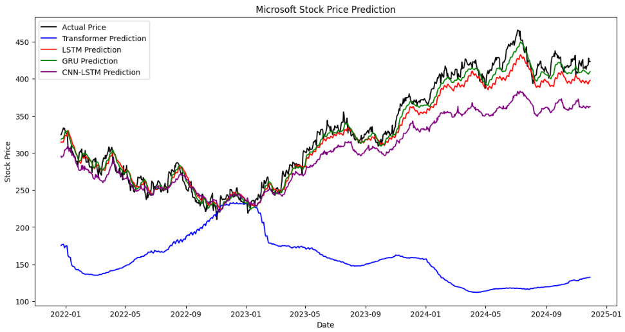
Visualizations of microsoft’s stock price prediction : Phase 1
Visualizations of microsoft’s stock price prediction : Phase 1
Visualizations of microsoft’s stock price prediction : Phase 2

Slide 15
Visualizations of microsoft’s stock price prediction : Phase 2
Visualizations of microsoft’s stock price prediction : Phase 2
Backtesting Results
Initial Portfolio Value: $10,000.
Final Portfolio Value: $16045.81.
Net Profit: $6045.81.
Performance:
Portfolio growth evaluated over time.
Line chart showing portfolio value during backtesting.
Include a summary table with ROI and number of trades.

Slide 16
Backtesting Results
Backtesting Results
Limitations
Initial Portfolio Value: $10,000.
Final Portfolio Value: $16045.81.
Net Profit: $6045.81.
Performance:
Portfolio growth evaluated over time.
Line chart showing portfolio value during backtesting.
Include a summary table with ROI and number of trades.
Initial Portfolio Value: $10,000.
Final Portfolio Value: $16045.81.
Net Profit: $6045.81.
Performance:
Portfolio growth evaluated over time.
Line chart showing portfolio value during backtesting.
Include a summary table with ROI and number of trades.
Challenges:
Simulated news may not reflect real-world sentiment.
Models may fail under high market volatility.
Backtesting excludes transaction costs and slippage.
Improvement Areas:
Use real-world news and live data.
Refine trading strategy with realistic constraints.
Add icons for challenges and solutions.

Slide 17
Limitations
Limitations
Future Work
Challenges:
Simulated news may not reflect real-world sentiment.
Models may fail under high market volatility.
Backtesting excludes transaction costs and slippage.
Improvement Areas:
Use real-world news and live data.
Refine trading strategy with realistic constraints.
Add icons for challenges and solutions.
Challenges:
Simulated news may not reflect real-world sentiment.
Models may fail under high market volatility.
Backtesting excludes transaction costs and slippage.
Improvement Areas:
Use real-world news and live data.
Refine trading strategy with realistic constraints.
Add icons for challenges and solutions.
Planned Enhancements:
Incorporate live financial news for sentiment analysis.
Fine-tune model hyperparameters for better predictions.
Explore ensemble methods to combine predictions.
Test strategies on other stocks or indices.
Roadmap diagram with milestones for future improvements.

Slide 18
Future Work
Future Work
THANK YOU !
Planned Enhancements:
Incorporate live financial news for sentiment analysis.
Fine-tune model hyperparameters for better predictions.
Explore ensemble methods to combine predictions.
Test strategies on other stocks or indices.
Roadmap diagram with milestones for future improvements.
Planned Enhancements:
Incorporate live financial news for sentiment analysis.
Fine-tune model hyperparameters for better predictions.
Explore ensemble methods to combine predictions.
Test strategies on other stocks or indices.
Roadmap diagram with milestones for future improvements.

Slide 19
Future Work
Real-Time News Integration: Use news APIs
Advanced NLP: BERT, GPT for better sentiment analysis
Hyperparameter Tuning: Grid search, Bayesian optimization
Feature Expansion: Technical indicators, macroeconomic variables
Robust Backtesting: Realistic trading conditions
Model Deployment: Real-time pipeline setup
THANK YOU !

